Slide 1
Contents
Design Issues
Routing Algorithms
Congestion Control
Quality of Service
Internetworking
Network Layer of the Internet

Slide 2
Contents
Design Issues
Routing Algorithms
Congestion Control
Quality of Service
Internetworking
Network Layer of the Internet

Slide 3
Datagrams vs Virtual Circuits
Issue | Datagram network | Virtual-circuit network
Circuit setup | Not needed | Required
Addressing | Each packet contains the full source & destination address | Each packet contains a short VC number
State information | Routers do not hold state information about connections | Each VC requires router table space per connection
Routing | Each packet is routed independently | Route chosen when VC is set up; all packets follow it
Effect of router failures | None, except for packets lost during the crash | All VCs that passed through the failed router are terminated
Quality of service | Difficult | Easy if enough resources can be allocated in advance for each VC
Congestion control | Difficult | Easy if enough resources can be allocated in advance for each VC

Slide 4
Contents
Design Issues
Routing Algorithms
Congestion Control
Quality of Service
Internetworking
Network Layer of the Internet

Slide 5

Routing Algorithms
Optimality principle
Shortest path algorithm
Flooding
Distance vector routing
Link state routing
Hierarchical routing

Slide 6
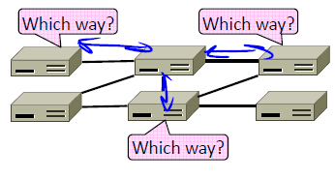
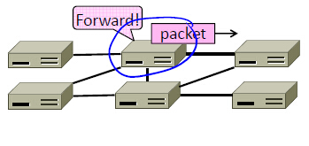
Routing vs Forwarding
Routing is the process of discovering network paths
Model the network as a graph of nodes and links
Decide what to optimize (e.g., fairness vs efficiency)
Update routes for changes in topology (e.g., failures)
Forwarding is the sending of packets along a path

Slide 7
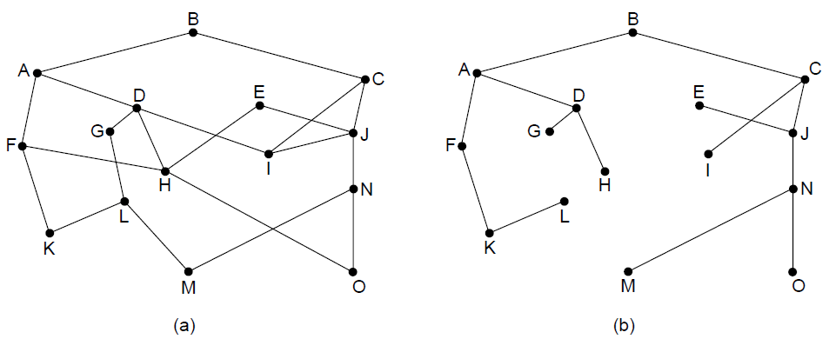
The Optimality Principle
Each portion of a best path is also a best path; the union of them to a router is a tree called the sink tree
Best means fewest hops in the example
B
Network
Sink tree of best paths to router B

Slide 8
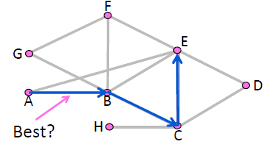
Shortest Path Routing
Defining “best” paths with link costs
Many possibilities:
Latency, avoid circuitous paths
Bandwidth, avoid slow links
Money, avoid expensive links
Hops, to reduce switching
But only consider topology
Ignore workload, e.g., hotspots

Slide 9
Shortest Path Routing
We’ll approximate “best” by a cost function that captures the factors
Often call lowest “shortest”
1. Assign each link a cost (distance)
2. Define best path between each pair of nodes as the path that has the lowest total cost (or is shortest)
3. Pick randomly to any break ties

Slide 10
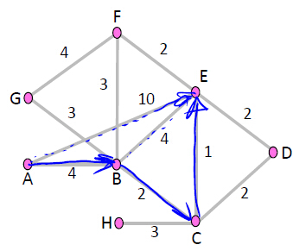
Shortest Path Routing
Find the shortest path from A to E
All links are bidirectional, with equal costs in each direction
– Can extend model to unequal costs if needed
Optimality property:
Subpaths of shortest paths are also shortest paths
ABCE is a shortest path
So are ABC, AB, BCE, BC, CE

Slide 11
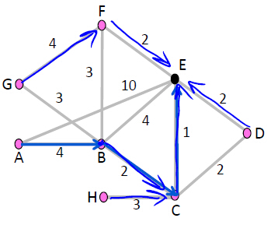
Sink Trees
Sink tree for a destination is the union of all shortest paths towards the destination
– Similarly source tree
Find the sink tree for E

Slide 12
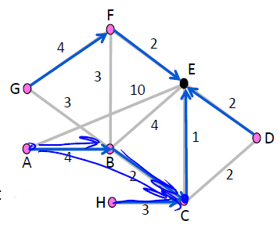
Sink Trees
Implications:
Only need to use destination to follow shortest paths
Each node only need to send to the next hop
Forwarding table at a node
Lists next hop for each destination
Routing table may know more

Slide 13
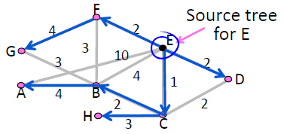
Shortest Path Algorithm
How to compute shortest paths given the network topology
– With Dijkstra’s algorithm

Slide 14
Dijkstra’s Algorithm
Dijkstra’s algorithm computes a sink tree on the graph:
Each link is assigned a non-negative weight/distance
Shortest path is the one with lowest total weight
Using weights of 1 gives paths with fewest hops
Algorithm:
Start with sink, set distance at other nodes to infinity
Relax distance to other nodes
Pick the lowest distance node, add it to sink tree
Repeat until all nodes are in the sink tree

Slide 15
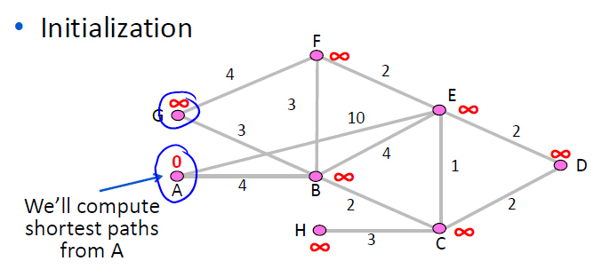
Dijkstra’s Algorithm

Slide 16
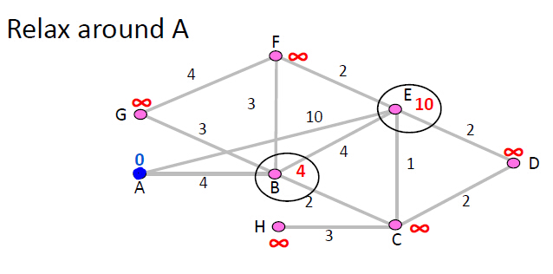
Dijkstra’s Algorithm

Slide 17
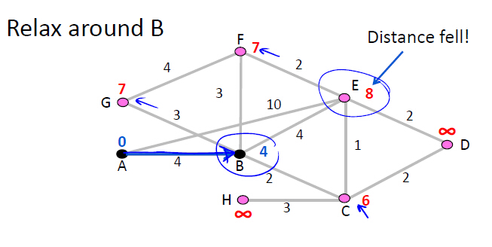
Dijkstra’s Algorithm

Slide 18
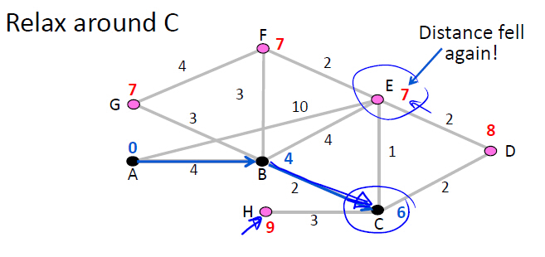
Dijkstra’s Algorithm

Slide 19
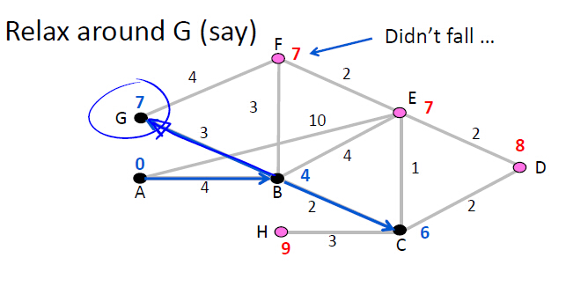
Dijkstra’s Algorithm

Slide 20
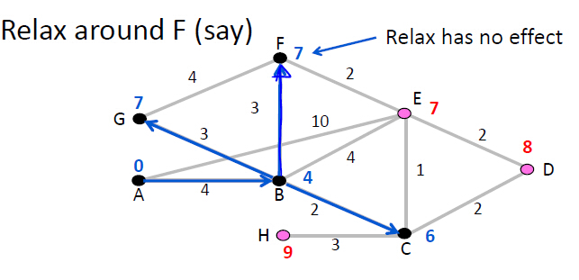
Dijkstra’s Algorithm

Slide 21
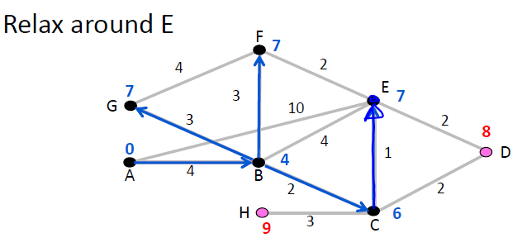
Dijkstra’s Algorithm

Slide 22
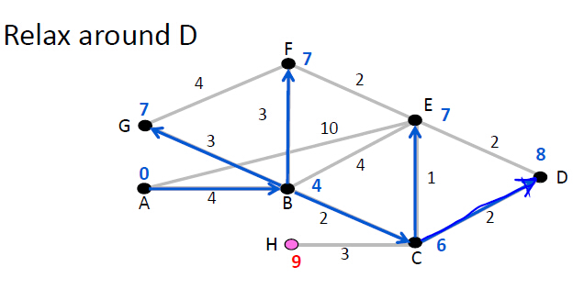
Dijkstra’s Algorithm

Slide 23
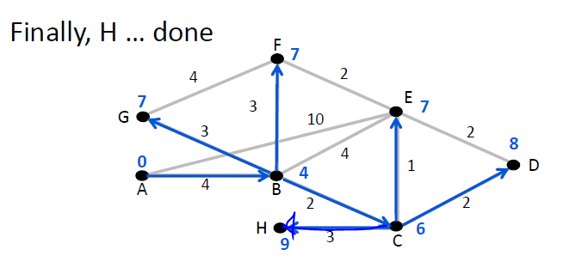
Dijkstra’s Algorithm

Slide 24
Dijkstra’s Algorithm
Finds shortest paths in order of increasing distance from source
Leverages optimality property
Runtime depends on efficiency of extracting min-cost node
Superlinear in network size (grows fast)
Gives complete source/sink tree
More than needed for forwarding!
But requires complete topology

Slide 25
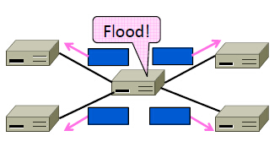
Flooding
How to broadcast a message to all nodes in the network with flooding
– Simple mechanism, but inefficient

Slide 26
Flooding
Rule used at each node:
Sends an incoming message on to all other neighbors
Remember the message so that it is only flood once
Inefficient because one node may receive multiple copies of message

Slide 27
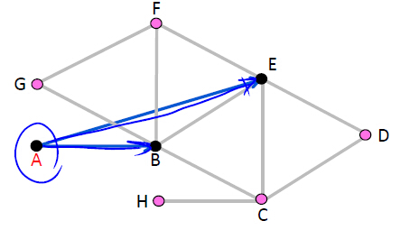
Flooding
Consider a flood from A; first reaches B via AB, E via AE

Slide 28
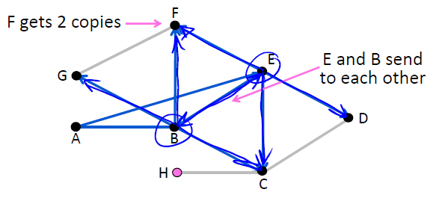
Flooding
Next B floods BC, BE, BF, BG, and E floods EB, EC, ED, EF

Slide 29
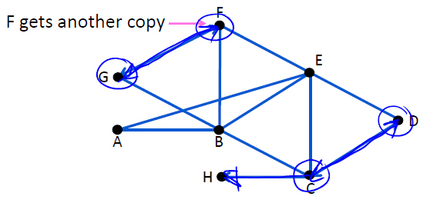
Flooding
C floods CD, CH; D floods DC; F floods FG; G floods GF

Slide 30
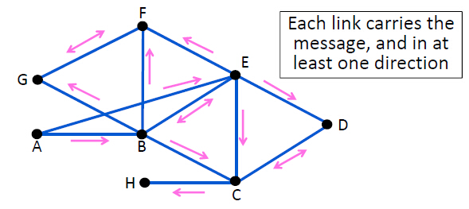
Flooding
H has no-one to flood … and we’re done

Slide 31
Flooding
Remember message (to stop flood) using source and sequence number
So next message (with higher sequence number) will go through
To make flooding reliable, use ARQ
So receiver acknowledges, and sender resends if needed

Slide 32
Distance Vector Routing
Distance vector is a distributed routing algorithm
Shortest path computation is split across nodes
Simple, early routing approach
Used in ARPANET, and RIP (Routing Information Protocol)
One of two main approaches to routing
Distributed version of Bellman-Ford
Works, but very slow convergence after some failures
Link-state algorithms are now typically used in practice

Slide 33
Distance Vector Routing
Each node computes its forwarding table in a distributed setting:
Nodes know only the cost to their neighbors; not the topology
Nodes can talk only to their neighbors using messages
All nodes run the same algorithm concurrently
Nodes and links may fail, messages may be lost

Slide 34
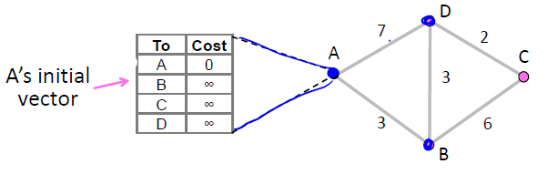
Distance Vector Routing
Consider a simple network. Each node runs on its own
E.g., node A can only talk to nodes B and D

Slide 35
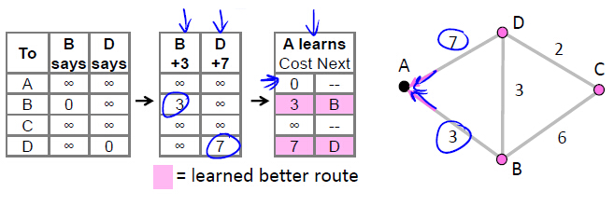
Distance Vector Routing
First exchange, A hears from B, D and finds 1-hop routes
– A always learns min(B+3, D+7)

Slide 36
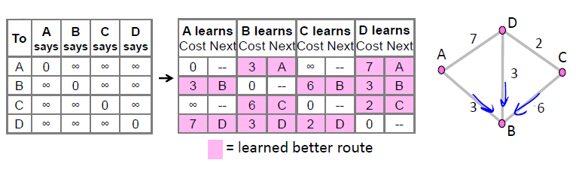
Distance Vector Routing
First exchange for all nodes to find best 1-hop routes
– E.g., B learns min(A+3, C+6, D+3)

Slide 37
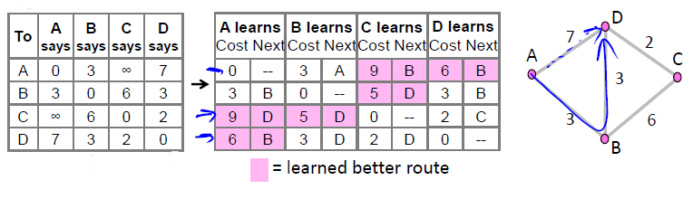
Distance Vector Routing
Second exchange for all nodes to find best 2-hop routes

Slide 38
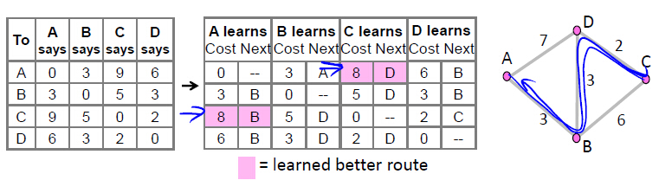
Distance Vector Routing
Third exchange for all nodes to find best 3-hop routes

Slide 39
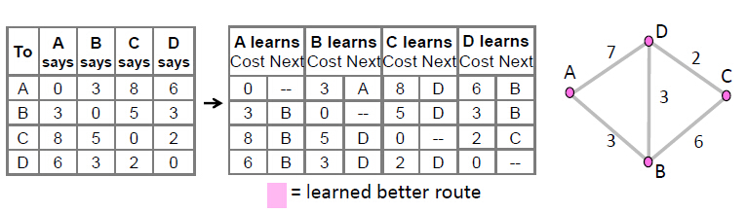
Distance Vector Routing
Fourth and subsequent exchanges; converged

Slide 40
Distance Vector Dynamics
Adding routes:
News travels one hop per exchange
Removing routes
When a node fails, no more exchanges, other nodes forget
But partitions (unreachable nodes in divided network) are a problem
“Count to infinity” scenario

Slide 41
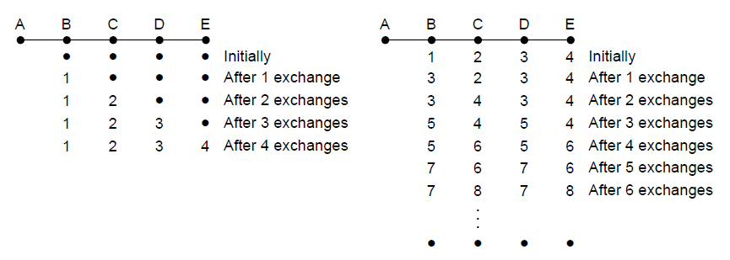
Distance Vector Dynamics
Failures can cause DV to “count to infinity” while seeking a path to an unreachable node
X
Good news of a path to A spreads quickly
Bad news of no path to A is learned slowly

Slide 42
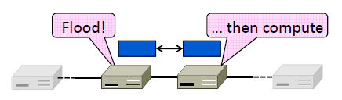
Link State Routing
One of two approaches to routing
Trades more computation than distance vector for better dynamics
Widely used in practice
Used in Internet/ARPANET from 1979
Modern networks use OSPF and IS-IS

Slide 43
Link State Routing
Nodes compute their forwarding table in the same distributed setting as for distance vector:
Nodes know only the cost to their neighbors; not the topology
Nodes can talk only to their neighbors using messages
All nodes run the same algorithm concurrently
Nodes/links may fail, messages may be lost

Slide 44
Link State Routing
Proceeds in two phases:
1. Nodes flood topology in the form of link state packets
– Each node learns full topology
2. Each node computes its own forwarding table
– By running Dijkstra (or equivalent)

Slide 45
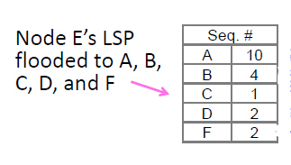
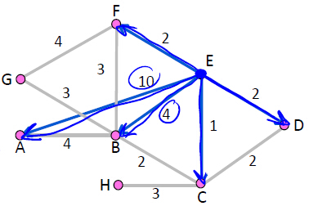
Link State Routing
Phase 1: Topology Dissemination
Each node floods link state packet (LSP) that describes their portion of the topology

Slide 46
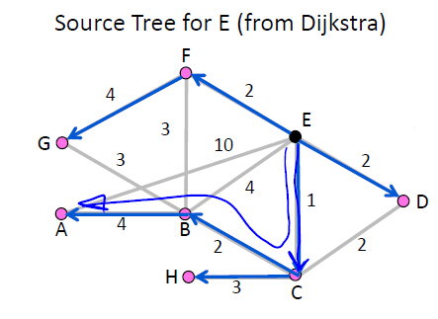
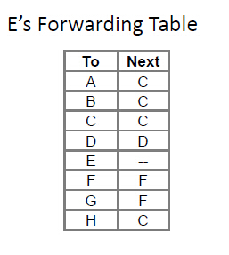
Link State Routing
Phase 2: Route Computation
Each node has full topology – By combining all LSPs
Each node simply runs Dijkstra
Some replicated computation, but finds required routes directly
Compile forwarding table from sink/source tree

Slide 47
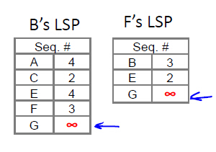
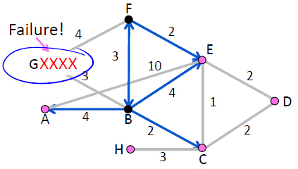
Link State Routing
Phase 3: Handling Changes
On change, flood updated LSPs, and re-compute routes
– E.g., nodes adjacent to failed link or node initiate
Link Failure and Node Failure

Slide 48
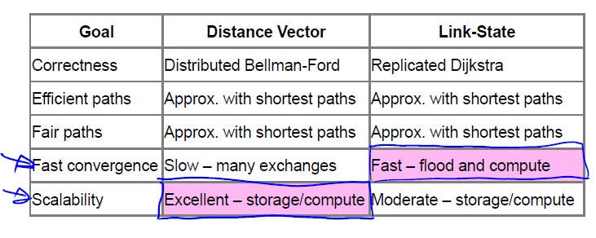
Distance Vector vs Link State Routing

